Slide 1
Secure Coding practices
Day 1

Slide 2
Agenda
Overview of Cyber Security attacks on source code
Overview of SSDLC life cycle Secure software Requirements
Data Validation & Processing Secure code programming
Input Validation and Output Encoding

Slide 3
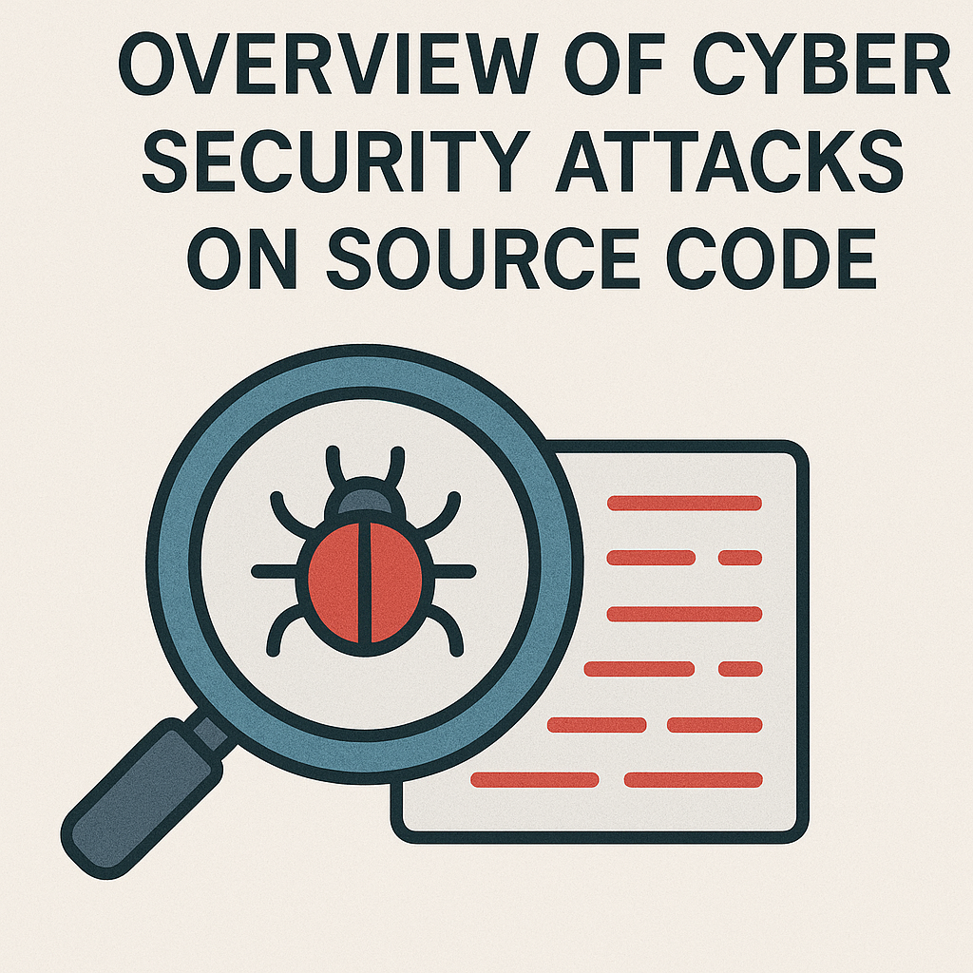

Slide 4
Overview of Cyber Security Attacks on Source Code
Cyber security attacks on source code typically target vulnerabilities in the code or build processes to exploit weaknesses.
Some common attacks include:
Code Injection: Malicious code inserted into legitimate source code to alter program behavior or introduce vulnerabilities.

Slide 5
Overview of Cyber Security Attacks on Source Code (Cont.,)
Backdoors: Hidden entry points left in the source code by developers or attackers, allowing unauthorized access.
Software Supply Chain Attacks: Targeting the libraries or dependencies a software project relies on.

Slide 6
Overview of Cyber Security Attacks on Source Code (Cont.,)
Code Reuse and Tampering: Attackers modify pre-existing code, either directly or indirectly, to introduce vulnerabilities or bypass security checks.
Reverse Engineering: Analyzing compiled code to understand its logic and find weaknesses that can be exploited.

Slide 7
Overview of SSDLC (Secure Software Development Life Cycle)
The SSDLC incorporates security into each phase of software development, ensuring secure code from inception to deployment:
Planning: Identifying security risks early and planning mitigations.
Design: Using secure design principles like the principle of least privilege, defense in depth, and security by design.

Slide 8
Overview of SSDLC (Secure Software Development Life Cycle) (Cont.,)
Implementation: Writing code that follows secure coding practices and employs secure libraries and dependencies.
Testing: Conducting security-focused testing (e.g., penetration testing, static analysis).

Slide 9
Overview of SSDLC (Secure Software Development Life Cycle) (Cont.,)
Deployment: Ensuring secure deployment through hardening, patching, and monitoring.
Maintenance: Regular updates and security patches to address newly discovered vulnerabilities.

Slide 10
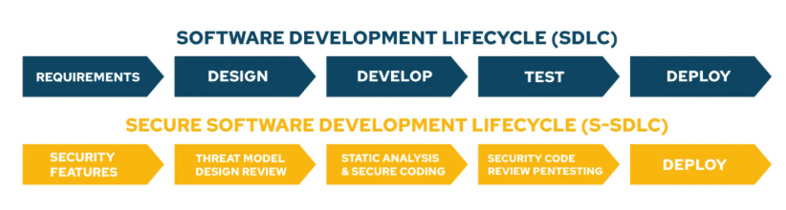
Overview of SSDLC (Secure Software Development Life Cycle)

Slide 11
Secure Software Requirements – SMART
Secure software requirements are critical to ensuring the software is secure from the beginning.
SMART is a mnemonic used to define specific, measurable, achievable, relevant, and time-bound objectives:
Specific: Requirements should be clear and well-defined.

Slide 12
Secure Software Requirements – SMART (Cont.,)
Measurable: Ensure that requirements can be quantitatively assessed.
Achievable: The requirement should be realistic.

Slide 13
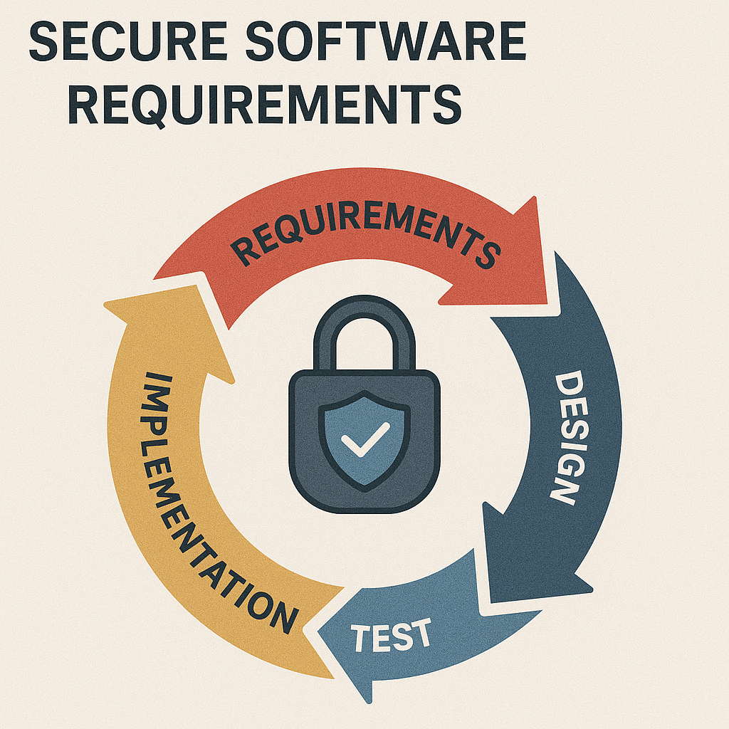

Slide 14
Secure Software Requirements – SMART (Cont.,)
Relevant: Ensure the requirement is applicable to security needs.
Time-bound: The requirement should have a deadline or timeframe.

Slide 15
Secure Software Practices
Secure Coding: Write code that prevents common vulnerabilities, such as SQL injection, buffer overflows, and cross-site scripting (XSS).
Access Control: Implement strict access controls to ensure users and systems only have the minimum privileges necessary.

Slide 16
Secure Software Practices (Cont.,)
Authentication & Authorization: Use strong methods like multi-factor authentication (MFA) and enforce proper session management.
Minimize Attack Surface: Only expose necessary functions and services, reducing the opportunities for exploitation.

Slide 17
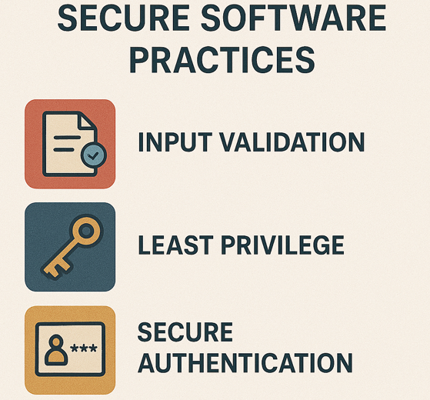

Slide 18
Secure Software Design Principles (Cont.,)
Fail Securely: Systems should fail in a secure manner, ensuring they do not inadvertently expose data or allow unauthorized access.
Separation of Duties: Different roles should be implemented in a way that no single user or entity has complete control over a system.

Slide 19
Secure Software Design Principles (Cont.,)
Defense in Depth: Use multiple layers of security measures to protect against attacks (e.g., firewalls, intrusion detection systems).

Slide 20
Data Validation & Processing
Proper validation ensures that input data conforms to expected formats, ranges, and types before being processed.
Insecure data validation often leads to injection attacks, buffer overflows, and other vulnerabilities.

Slide 21
Data Validation & Processing (Cont.,)
Techniques include:
Input Validation: Ensuring inputs meet expected types, lengths, and formats.
Sanitization: Cleaning input data to remove harmful code (e.g., SQL injection or XSS).

Slide 22
Data Validation & Processing (Cont.,)
Escaping Output: Preventing dangerous characters from executing when data is output to users or other systems.

Slide 23
Secure Code Programming – CERT and SANS 25
CERT (Computer Emergency Response Team) and SANS (SysAdmin, Audit, Network, and Security) are organizations that maintain lists of secure coding practices.

Slide 24
Secure Code Programming – CERT and SANS 25 (Cont.,)
CERT Secure Coding Standards: A set of best practices designed to help programmers avoid common programming errors leading to security vulnerabilities.
Examples include avoiding buffer overflows and proper memory management.

Slide 25
Secure Code Programming – CERT and SANS 25 (Cont.,)
SANS Top 25: A list of the 25 most dangerous programming errors that expose applications to attack.
These include improper validation of input, lack of encryption, and poor session management.

Slide 26
Securing Artifacts Deployed on Target Machines
Once software is deployed, it’s important to secure the deployed artifacts. Strategies include:
Code Obfuscation: Making the code difficult to reverse-engineer by using obfuscation techniques.
Encryption: Encrypting sensitive data, both at rest and in transit.

Slide 27
Securing Artifacts Deployed on Target Machines (Cont.,)
File Integrity Checks: Using tools to monitor changes to key files and binaries.
Least Privilege: Ensure deployed artifacts have the minimum permissions necessary.

Slide 28
Protection of Devices Against Vulnerabilities Over Ethernet
Ethernet-based devices are vulnerable to attacks such as man-in-the-middle (MITM) or eavesdropping. Protecting these devices includes:
Encryption: Secure communication over Ethernet using protocols like TLS or IPsec.
Network Segmentation: Isolating critical systems from less-secure networks.

Slide 29
Protection of Devices Against Vulnerabilities Over Ethernet (Cont.,)
Firewalls: Implementing firewalls to filter malicious traffic.
Regular Patching: Ensuring firmware and software are up to date with the latest security patches.

Slide 30
Secure Code by Design – Threat Modelling (STRIDE)
STRIDE: A framework for identifying threats in the design phase. It stands for:
Spoofing identity
Tampering with data
Repudiation (denial of actions)
Information Disclosure
Denial of Service (DoS)
Elevation of Privilege

Slide 31
Secure Code by Design – Threat Modelling (DREAD)
DREAD: A risk assessment model used to prioritize threats:
Damage potential
Reproducibility
Exploitability
Affected users
Discoverability

Slide 32
Cryptographic Practices
Cryptography is essential for securing data both in transit and at rest. Best practices include:
Use Strong Algorithms: Such as AES for encryption and RSA for public-key cryptography.
Key Management: Ensuring keys are stored securely and rotated regularly.

Slide 33
Cryptographic Practices (Cont.,)
Hashing: Using secure hash functions (e.g., SHA-256) to store sensitive data like passwords.
TLS/SSL: Securing communication channels with HTTPS.

Slide 34
Input Validation and Output Encoding – Sanitization and Zero Trust Principle
Input Validation: Validate all inputs to ensure they meet the expected format and prevent attacks like SQL injection and XSS.
Output Encoding: Encode output to prevent malicious data from being interpreted as executable code.

Slide 35
Input Validation and Output Encoding – Sanitization and Zero Trust Principle (Cont.,)
Zero Trust Principle: Assume that all requests, whether internal or external, are potentially malicious.
Continuously verify identities and trustworthiness.

Slide 36
Security Testing with SAST, DAST Tools and Fuzz Testing
SAST (Static Application Security Testing): Analyzes source code or binaries for vulnerabilities without running the program. It is best suited for early in the development cycle.
DAST (Dynamic Application Security Testing): Tests running applications by attempting to exploit vulnerabilities and identify potential risks during operation.

Slide 37
Security Testing with SAST, DAST Tools and Fuzz Testing (Cont.,)
Fuzz Testing: Involves sending random, invalid, or unexpected data to the application to identify security weaknesses or crashes.
Fuzz Testing can be applied to both Windows and Linux environments to check for vulnerabilities in user inputs, network protocols, or system interactions.

Slide 38
Plugins for Debugging C++ Files in IDE
Popular IDEs for C++ development, such as Visual Studio and CLion, support various debugging plugins that assist in finding and fixing security vulnerabilities:
Visual Studio: Tools like Static Code Analysis, Visual Studio Debugger, and ReSharper C++ provide insights into code quality and security.

Slide 39
Plugins for Debugging C++ Files in IDE (Cont.,)
CLion: Integrated with GDB or LLDB for powerful debugging. It also supports static analysis tools like Cppcheck and Clang-Tidy.
Eclipse CDT: Offers plugins like Valgrind and gdb for memory error detection and debugging.

Slide 40
Summary
In this session we discussed about the overview of secure software development covers cyber attacks, SSDLC, Secure Design, and Secure Coding Practices.
Also the major key practices such as setting SMART requirements, secure design principles, thread modeling and employing cryptography.
We concluded with the framework of security testing using tools like SAST, DAST, and fuzz testing.

